Slide 1
SEF
Code Design Fundamentals

Slide 2
Reading
Code Design Fundamentals
Code Complete: Chapters 4 and 5
  In Chapter 4, pay particular attention to:
    section 4.1 (Selecting a Programming Language) and the "Language-Selection Quick Reference" within it
    section 4.4 (Selection of Major Construction Practices)
For next week: Code Complete: Chapter 7

Slide 3
What is Software Design?

Slide 4
What is "Software Design"?
Code Design Fundamentals
McConnell defines it as
  “The conception, invention, or contrivance of a scheme for turning a specification for a computer program into an operational program.”
He describes software design a number of different ways
  It is a Wicked Problem
  It is a Sloppy Process
  It is all about Trade-offs and Priorities
  It involves Restrictions
  It is Non-Deterministic
  It is a Heuristic process
  Sounds fantastic doesn’t it ?!?!

Slide 5

Design is a Wicked Problem
Code Design Fundamentals
A wicked problem is defined as one that could be clearly defined only by solving it or by solving part of it.
  Classic real-world example from the text - the Tacoma Narrows Bridge
How does this work with software?
  Sometimes you have to make prototypes that demonstrate problematic aspects of the software
    e.g. user interface
    e.g. communication with some hardware to do simple operations

Slide 6

Design is a Sloppy Process
Code Design Fundamentals
You usually have to take multiple passes at a design solution
  And at the end of the day, you can always still improve
Also, how much detail and design is enough?
  McConnell's answer ? When you're out of time

Slide 7
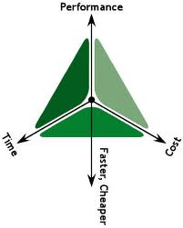
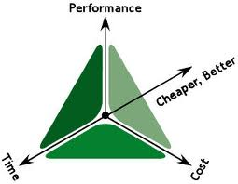
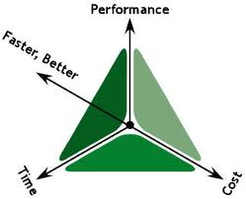
Design is About Trade-offs and Priorities
Code Design Fundamentals
Often times in the design of a program or a system, you are dealing with finite resources
  e.g. in an embedded system, you often have to deal with a small amount of memory
You often have a large set of requirements but not enough time to do them all so you’d have to decide which to implement – you would have to prioritize
  This is often a problem, as your priorities and needs would likely be different from those in marketing and perhaps even the customer

Slide 8

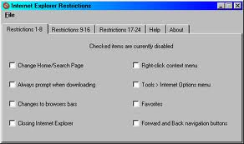
Design Involves Restrictions
Code Design Fundamentals
Often times in designing software or a system, there are restrictions and limitations that we must deal with and work within
  For example :
    You might need a version that runs under Windows 8, MacOS, and Linux …

Slide 9
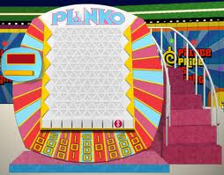
Design is Non-Deterministic
Code Design Fundamentals
There's multiple ways of coming up with a solution to the same problem.
  e.g. There’s a lot of different ways to get from Fischer-Hallman and Ottawa to King and University, each with their own benefits and problems

Slide 10

Design is a Heuristic Process
Code Design Fundamentals
A heuristic can be described as an experience-based technique for problem solving, learning and discovery
  Heuristic == Rule of thumb == Thing to try that sometimes work
    e.g. waterfall technique of software design
    e.g. pseudocode
    e.g. baby steps
    e.g. requirements analysis
    e.g. unit testing

Slide 11
Software Design
How to manage the process ?
What do we need to think of and do while designing ?

Slide 12


Software Design’s Issue
Code Design Fundamentals
According to McConnell
  The primary technical imperative in software design and development is managing complexity
When projects do fail for reasons that are primarily technical ... the software is allowed to grow so complex that no one really knows what it does

Slide 13

Code Design Fundamentals
When a project reaches the point at which no one really understands the impact that code changes in one area of the system or program will have on other areas …
… progress grinds to a halt

Slide 14


Code Design Fundamentals
We should try to organize our programs in such a way that we can safely focus on one part of it at a time
The goal is to minimize the amount of a program you have to think about at any one time

Slide 15
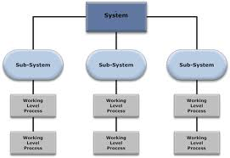
How do we Reduce Complexity?
Code Design Fundamentals
Okay – so it sounds like we need to reduce the complexity of the software or system … how do we do that ?
  ANSWER : Divide the system into subsystems and manage each sub-system
    Here is a generic structure of a system

Slide 16
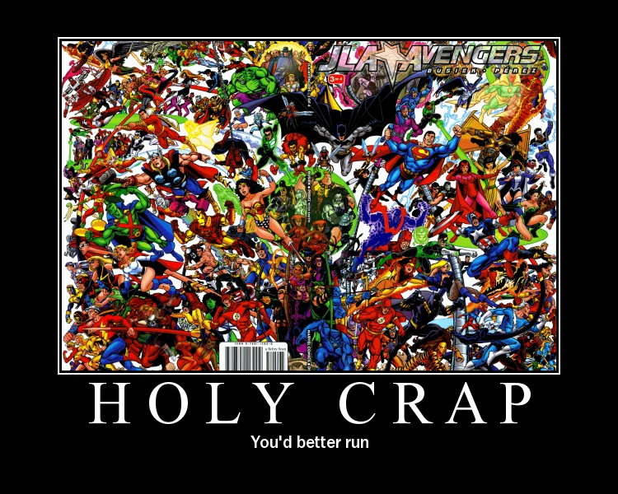
Desirable Characteristics of a Design
Code Design Fundamentals
When designing a system, you need to be aware of certain desirable characteristics …
  Ease of maintenance
  Minimal complexity
  Minimal connectedness
  Extensibility
  Reusability
  High fan-in
  Low-to-medium fan-out
  Portability
  Leanness
  Standard Techniques
  Stratification

Slide 17
Ease of Maintenance
Code Design Fundamentals
Which of the following blocks of code do you think would be easier to maintain?
int tbchar(int C)
{
int t = C/8;
if(t < 9)
{
C += 8 - (C%8);
}
return C;
}
int convertTAB(int col)
{
int tab = col / 8;
// only move to next TAB stop
// if not at the end
if(tab < 9)
{
// advance to the next TAB
// stop (every 8 columns)
col += 8 - (col % 8);
}
return col;
}

Slide 18
Minimal Complexity
Code Design Fundamentals
Aka The KISS Principle
int tbchar(int C)
{
int t = C/8;
if(t < 9)
{
C += 8 - (C%8);
}
return C;
}
int tbchar(int C)
{
int tabStop[80] = { 9, 9, 9, 9, 9, 9, 9, 9, 9, 17, 17, /* etc */ };
return tabStop[C];
}
Which one of these blocks of code appears to be less complex ?
  Why ?

Slide 19
Minimal Connectedness
Code Design Fundamentals
Make different parts of a program as independent from one another as possible
Design well-defined interfaces to the different subsystems and routines
  If you wanted to create a file search utility that stores filenames, sizes, dates, etc. in a database
    You would create separate modules (sub-systems) - database, user input, query creation, output display
    You would create well-defined interfaces to these modules
      e.g. database interface
        initialize database connection
        search for file (file characteristics)
        get file results(file characteristics)

Slide 20
Extensibility
Code Design Fundamentals
You should be able to add to the system (extend the system’s behaviour / capabilities) without causing massive side-effects to the existing system
  Again, the file search utility
    Currently it stores filenames, sizes, dates, etc. in a database
    Let’s add the ability to search the contents of files (within the file)

Slide 21
Reusability
Code Design Fundamentals
Design so that you can readily and easily reuse parts of your design in other programs or systems
  That is – you want to design so that sub-systems, modules, and/or functions can be reused
  e.g. rangeCheck() function from C assignment #2

Slide 22
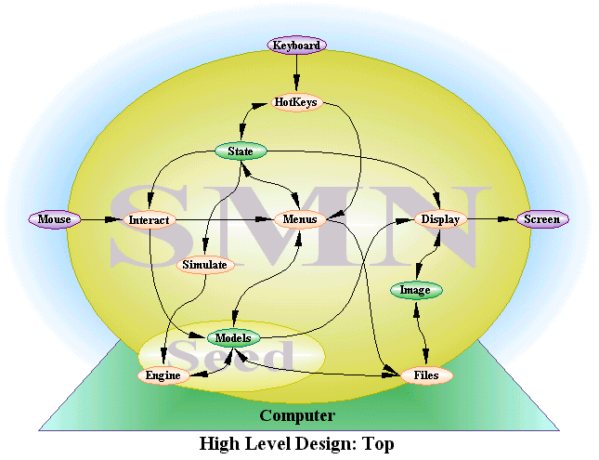
High Fan-in
Code Design Fundamentals
Having many subsystems using a particular subsystem
  e.g. you can see that the Menus subsystem below is being used by the HotKeys, State, Interact, & Models subsystem

Slide 23
Low-to-Medium Fan-out
Code Design Fundamentals
Not using many other modules from within a module
  e.g. the modules below can be independent from one another
More details on Fan-In vs. Fan-Out

Slide 24
Portability
Code Design Fundamentals
When designing your system, make sure that you design with portability in mind – so that it is easily movable to other operating environments
  e.g. a Windows application being brought to Linux or Mac
  These concepts will be taught to you throughout your SET career

Slide 25
Leanness
Code Design Fundamentals
No extra unnecessary parts – only design and implement that which is necessary to meet the requirements
  e.g. in the file search utility, don’t add in the ability to rename, delete or move files … it’s a search utility !

Slide 26
Standard Techniques
Code Design Fundamentals
Whenever possible, follow industry standards and best practices
  Familiarity is good and helps with understanding and also allows complete teams of developers to work on a single project
    e.g. UI / GUI standards

Slide 27
Stratification
Code Design Fundamentals
Design in layers so that you can get a good handle on the system’s behaviour layer-by-layer

Slide 28
Software Design
Discussion of various Design Approaches …

Slide 29
Design by Level
Code Design Fundamentals
When designing your system (or your software), a typical approach to take is Level by Level
  First you have your overall software system
  Then you divide it into subsystems
  Then further divide the subsystems into programs
  Then divide your programs into classes or modules
  Then you divide your classes or modules into the data and routines (i.e. into methods or functions)
  Finally you have the creation of the methods and functions internal routines

Slide 30
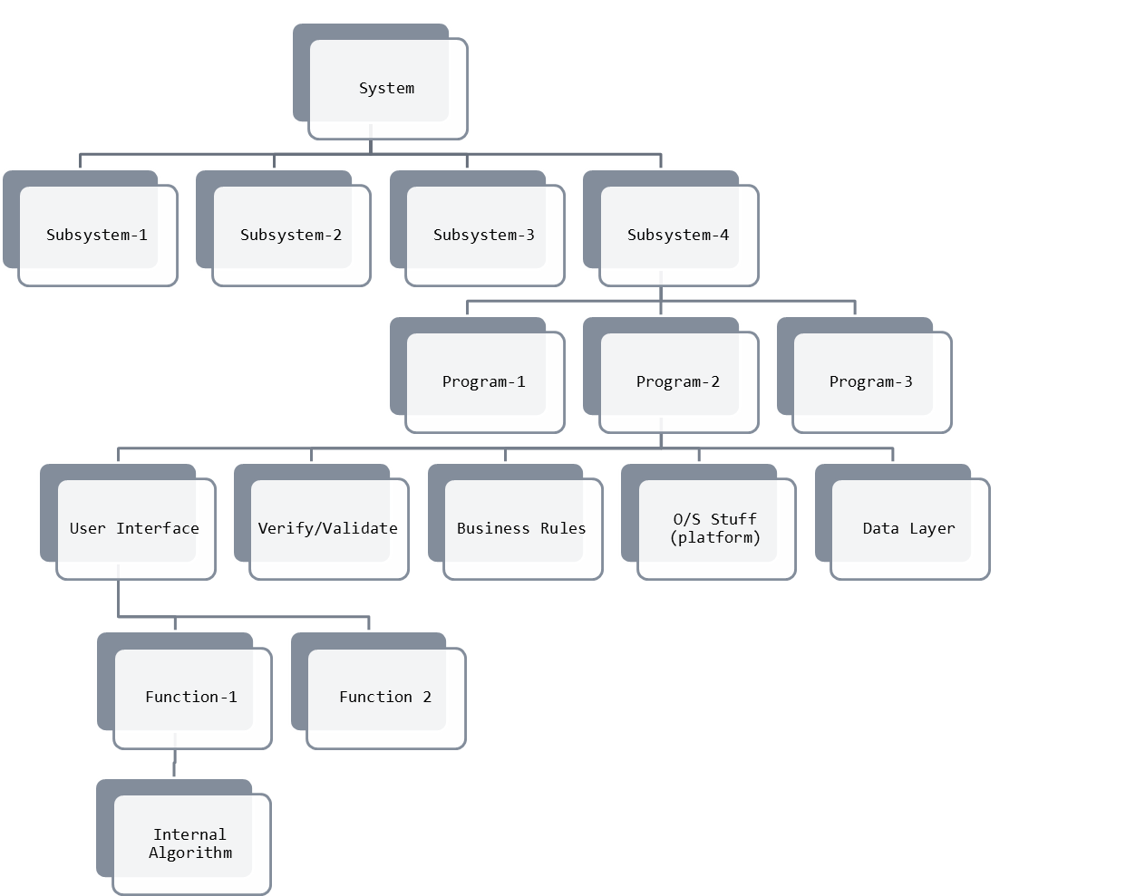
Code Design Fundamentals
Interfaces (defines how the units communicate)
1000’ Level
Level 1
Level 2
Level 3
100’ Level
Level 4
Buffer to Hide Information
Level 5
Level 6
Street Level

Slide 31

Level 1 – The System
Code Design Fundamentals
It's best to get an overview of the entire system first before starting the design
  This comes from initial project documents (including the SRS), customer meetings, focus groups, etc.
How can you design an effective system
if you don’t have the big picture ?

Slide 32
Level 2 – The Division into Subsystems
Code Design Fundamentals
Divide the system into smaller, logically-described subsystems.
  Where each subsystem serves to implement a portion of the overall system’s purpose
Then decide on how the subsystems will interact with one another
  This is vitally important, as you have to keep control over interactions
    These interactions define how one subsystem can talk to another
    Really you define the interfaces to each subsystem

Slide 33

Analogy to help you remember …
Code Design Fundamentals
You might think of the lines between subsystems as being hoses with water running through them
  If you want to reach in and pull out a subsystem, that subsystem is going to have some hoses attached to it. The more hoses you have to disconnect and reconnect, the wetter you will get
You want to architect your system so that if you pull out a subsystem to use elsewhere you won't have very many hoses to reconnect and those hoses will reconnect easily

Slide 34
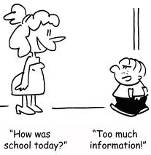
Guidelines on Defining an Interface
Code Design Fundamentals
Allow communication between subsystems on a need-to-know basis
  And even then, it had better be for a good reason.
If in doubt, it's easier to restrict communication early and relax it later than to relax it early and then try to tighten it up later after you've coded several hundred inter-subsystem calls

Slide 35
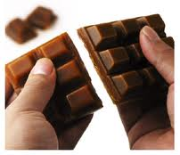
Level 3 – The Division Into Programs
Code Design Fundamentals
Subsystems can be broken up into many individual programs
  Each program serving a portion of the overall subsystem’s central purpose
  Remembering also that it may be possible that these programs also need to communicate with each other (an interface)

Slide 36

Level 4 – The Division Into Classes / Modules
Code Design Fundamentals
A class or modules is a smaller part of a program
  It is self-contained, with a well-defined interface
  You should divide each program into its appropriate classes or modules where each chunk has a specific reason for being … a specific purpose
    UI
    Data Verification and Validation
    Business Logic
    System Dependencies (O/S, platform specifics)
    A data handling layer perhaps
NOTE Even though the term class is heavily used in object-oriented programming, the term also has its usefulness in procedural programming (like C)

Slide 37
Level 5 – The Division Into Routines
Code Design Fundamentals
For each class or module, come up with the routines (functions and methods) that define its behaviour
  You also need to consider the data that will be handled and manipulated by these routines

Slide 38
Level 6 – The Internal Routine Design
Code Design Fundamentals
This is the step where you come up with the design for each routine, at a pre-code level
  Perhaps use pseudo-coding as a tool here or some other loose definition language
  More on this in the next lesson …

Slide 39
Other Helpful Design Ideas
Code Design Fundamentals
One thing to note is that there is no one correct way to design a system / piece of software …
A good approach to design is to take other people’s ideas and concepts, best practices, etc.
  And use whatever you need to to get the job done – and get it done right (re: desired system characteristics)
Some other approaches include :
  Heuristics
  Using real-world objects
  Use of abstractions
  Encapsulate ideas
  Inherit where possible
  Use information hiding

Slide 40
Design Idea : Heuristics
Code Design Fundamentals
Definitions:
  A computational method that uses trial and error methods to approximate a solution for computationally difficult problems
  A method employing experimentation, evaluation, and trial-and-error methods to learn, discover, understand, or solve problems
  Rules, suggestions, guides, or techniques that may be useful in making progress toward a solution of a problem
The concept of using heuristics in design is to never be afraid to experiment if you are faced with a problem that you don’t know how to solve off the top of your head
  Through experimentation, we have discovery – the experimentation is based on experience, suggestions and guidelines
    Always take what you know as a foundation and build upon it

Slide 41
Design Idea : Find Real-World Objects
Code Design Fundamentals
In the design of certain systems, it may be possible to model it (and its behaviour) on a real-world object(s)
  We’ll be looking at this next term in C++
How To :
  Identify the objects and their attributes
  Determine what can be done to each object
  Determine what each object can do to other objects
  Determine the parts of each object that will be visible to other object
  Define each object's public interface

Slide 42
Design Idea : Form Consistent Abstractions
Code Design Fundamentals
What is abstraction ?
  The ability to engage with a concept while safely ignoring some of its details
The idea of using abstraction in design is to reduce complexity by focusing on interfaces between items (subsystems, classes, routines, etc.) instead of the details of the internals

Slide 43

Design Idea : Encapsulate Implementation Details
Code Design Fundamentals
Abstraction says :
  You're allowed to look at an object at a high level of detail
Encapsulation says :
  Furthermore, you aren't allowed to look at an object at any other level of detail
In other words, don't sweat the details
  You can handle the details at a later
  point in time

Slide 44
Design Idea : Use Inheritance
Code Design Fundamentals
What is inheritance ?
  The act of basing one object on a simpler object and expanding its behaviour
Don’t be afraid to use inheritance when it simplifies the design
  Covered more next semester in C++

Slide 45

Design Idea : Information Hiding
Code Design Fundamentals
Again this is an object oriented concept that deals with hiding information within a class
  That way, you don't have to worry about the details (again).
In C you’ve already discussed this idea
  In the example of local variables instead of global variables.
  You will also cover it when you discuss the idea of hiding functions.
Remember - the interface to a class should reveal as little as possible about its inner workings

Slide 46
Reasons to Hide Information …
Code Design Fundamentals
Here are a couple of reasons why good designers adopt this information hiding idea …
  Hiding complexity so that your brain doesn't have to deal with it unless you're specifically concerned with it
  Hiding sources of change so that when change occurs the effects are localized

Slide 47
Software Design
Okay – we’ve designed it … but now it needs to change !

Slide 48
Accommodating Change
Code Design Fundamentals
Hopefully from previous SEF lessons, you have been conditioned to think and realize that as soon as things are set – they will change …
  The question here is, how do we deal with change while trying to design a system / software
Here are some ideas to help you …
  While you are originally designing the system / software
    Identify items that seem likely to change
    Separate items that are likely to change
    Isolate items that seem likely to change

Slide 49
Typical Areas Of High Change
Code Design Fundamentals
Business-related items (the business logic)
Hardware
Input and output (from the UI/GUI to the actual data needed)
Nonstandard language features
Difficult design and construction areas
Status variables
Data size constraints

Slide 50
How to separate and isolate
Code Design Fundamentals
Okay – so now you’ve got to separate and isolate areas of your system / design which are like to change …
  How do you do that ??
  The answer is easy – you do this by ensuring you have loose coupling …

Slide 51
?? Coupling ??
Code Design Fundamentals
What is coupling ?!?!
  Coupling describes how tightly a module (class or routine) is related to other modules … how much the execution of a module depends on the execution of another
  Good coupling between modules is loose enough that one module can easily be used by any other module
How do you make sure you have loose coupling ??
  Try to create modules that depend little on other modules
    Don’t have one module directly reference or modify data that is held by another module
    Don’t allow modules to share global data!
    Don’t allow one module to control the sequence flow in another by passing control flags

Slide 52
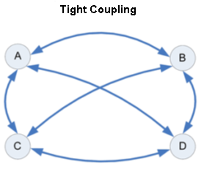
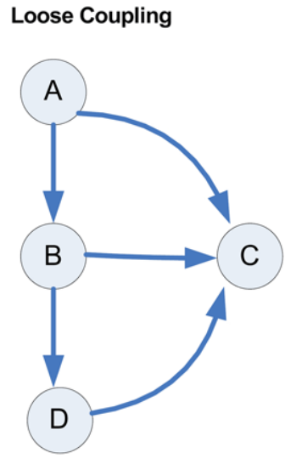
Code Design Fundamentals
In this example, if A changes, it impacts B, C and D
If B changes it impacts A,C and D
etc.
In this example, if A changes it does not impact B, C or D
If B changes then it impacts only A
If C changes then it impacts A, B and D
etc.

Slide 53
An example of Coupling …
Code Design Fundamentals
. . .
#define MANIPULATE 1
#define DON’T_MANIPULATE 0
int someBadGlobalControlVariable = 0;
// PURPOSE: This function takes a couple of parameters from somewhere else in the
// program and examines them … depending on their values, this function may choose
// to manipulate a “global” variable [Don’t tell Carlo ☺] so that this function can
// therefore control the behaviour of another function
int function-01-The-Nosey-Parker(int param1, int param2)
{
if((param1 > param2) && ((param1 * param2) > 15)) // some bizarre condition
{
// let’s set a global to control the behaviour of another function
someBadGlobalControlVariable = MANIPULATE;
}
. . .
// NOTE: this function continues, but never calls function-02-The-Manipulated-Function()
// directly … yet through the above setting of the global – this function is controlling
// the other … this function is tightly coupled to the other!
. . .
}
// PURPOSE: This function takes values X and Y and makes sure that these coordinates fall into
// Quadrant-I in Cartesian Space.
// RETURNS: 1 = to indicate that (x, y) are in Quadrant-I
// 0 = to indicate that the coordinates are not in Quadrant-I
// -1 = to indicate other outside influence at work … ☹
int function-02-The-Manipulated-Function(int x, int y)
{
int retCode = 0;
if(someBadGlobalControlVariable == MANIPULATE) retCode = -1;
. . .
return(retCode);
}

Slide 54
What else can I do to isolate ?
Code Design Fundamentals
Okay, so in order to separate and isolate – we need to ensure that the classes/modules and the methods/functions are loosely coupled … is there anything else ?
  You know that there is … ☺
  McConnell also gives us the target of aiming for strong cohesion …

Slide 55
Aim For Strong Cohesion
Code Design Fundamentals
What is cohesion?
  Cohesion refers to how closely all the routines in a class or module supports a central purpose
  Cohesion is a very good tool for also managing and gauging the complexity of the code and design
    If a class has a number of routines / methods within it for a smattering of different purposes, then it is a poor design (no central purpose) and it may lead to a more complex design
      This would be an example of having weak cohesion
How do you make cohesion strong ?
  When your class or module has a single, solitary, central purpose and all of the methods and functions in that class/module support that purpose – you have strong cohesion

Slide 56
Summary of Heuristics
Code Design Fundamentals
McConnell mentions many other heuristics for designing software. Many won't make sense to you until we work with Object-Oriented Programming next semester
  Find real-world objects
  Form consistent abstractions
  Encapsulate implementation details
  Inherit when possible
  Use information hiding
  Identify areas likely to change
  Keep coupling loose
  Look for common design patterns
  Aim for strong cohesion
  Build hierarchies
  Formalize class contracts
  Assign responsibilities
  Design for test
  Avoid failure
  Choose binding time consciously
  Make central points of control
  Consider using brute force
  Draw a diagram
  Keep your design modular

Slide 57
Guidelines for Using Heuristics
Code Design Fundamentals
McConnell also refers to some research of G. Polya’s (from 1957) which gives a generalized way to solve any mathematics problem.
This same approach can be used when solving any problem in software design and employing the various heuristics
The 4 Step approach is :
  Understand the problem
  Devise a plan
  Carry out your plan
  Look back and examine the solution

Slide 58
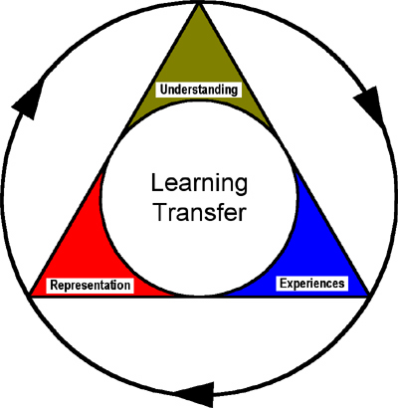
Step 1. Understand the Problem
Code Design Fundamentals
What is the unknown?
What are the givens .. the data that you know?
What are the conditions?
Draw a diagram to help you understand and see the problem …
Separate the various parts of the condition

Slide 59

Step 2. Devising a Plan
Code Design Fundamentals
Find the connection between the data and the unknown
Have you seen the problem before ?
  Or in a slightly different form?
  Can you restate the problem?
Can you imagine a more accessible related problem?
  A more general problem?
  A more special problem?
Can you solve a part of the problem?
Can you keep only a part of the condition and drop the other part?

Slide 60

Step 3. Carry Out Your Plan
Code Design Fundamentals
Check each step.
  Can you see clearly that the step is correct?
  Can you prove that it’s correct ?

Slide 61

Step 4. Look Back and Examine the Solution
Code Design Fundamentals
Can you check the result?
  Can you derive the result differently ?
  Can you see it at a glance ?
Can you use the result ?
In the end – you have to ask yourself … did I solve the problem adequately ?

Slide 62
Software Design
Design Practices

Slide 63
Design Practices
Code Design Fundamentals
Again, there are many, many ways that you can design a system or piece of software.
Here are a couple of different strategies that you can take that often produce good results:
  Iterate
  Divide and Conquer
  Top-Down and Bottom-Up design approaches
  Experimental Prototyping
  Collaborative Design

Slide 64

Strategy 1 : Iterate
Code Design Fundamentals
Redo designs to see if you can improve them
  When you come up with the first design that works – don’t stop !
  The second attempt is nearly always better …
    Because you will use lessons learned in the first design in creating the second !
      BTW – this basic idea is one of the foundations of the Agile Methodology for system and software design and development – which you will learn
    You will know what this means after you design your first solution in the work place … you will revisit it in your mind years later and say
      Wow ! Was that design ever poor, I could have done …
  Edison tried over a thousand different materials for the light bulb’s filament before he found the solution
    When asked later if he thought that he wasted time he quickly replied … “Nonsense, I have discovered a thousand things that don’t work .”

Slide 65

Strategy 2 : Divide and Conquer
Code Design Fundamentals
Dijkstra once pointed out that “no one’s skull is big enough to contain all the details of a complex problem.”
  So you need to break the problem down into smaller, more palatable (easier to tackle) pieces and solve each of the smaller problems
Carlo probably described this approach to you in a top-down approach in C by getting you to ask yourself :
  Do I know how to do this easily?
    If not – then break it down !

Slide 66



Strategy 3 : Top-Down Approach
Code Design Fundamentals
Begin at a high level of abstraction
  Think about the system in general and try to break it into its logical, functional components
  Take each component and iterate this approach again (breaking it into smaller functional components) – try to see what larger tasks need to be completed
  Increase the level of detail as you design through each iteration
Basically you start with a skeleton of the design and through each iteration, you add more meat to the bones
→ →

Slide 67

Strategy 3 : Bottom-Up Approach
Code Design Fundamentals
Start with the details that you do know about the system and work your way up
  This is most useful if the level of abstraction in top-down is too abstract to get your mind around
  Also sometimes you only know some low-level details about the system – so start with the details you know and work upwards from there
Question: "What do I know this system needs to do?"
  Next step
    Identify concrete objects and responsibilities from that question
  Next step
    Identify common objects and group them
  Next step
    Continue with the next level up or go back to the top
    and try to go downward again
Basically we are trying to see the forest for the trees …

Slide 68
Strategy 4 : Experimental Prototyping
Code Design Fundamentals
If you can come up with an approximation, try it out!
Sometimes you cannot know if a design will work until you better understand some of the implementation details
  Prototyping can be dangerous for developers as they
    Have a hard time just coding the bare minimum to prove a concept
    Have a hard time potentially throwing away the prototype in favour of properly designing around what they have learned
      So the quickly-thrown-together prototype becomes the solution
    Sometimes try to prototype too vague of an idea

Slide 69

Strategy 5 : Collaborative Design
Code Design Fundamentals
As with most things in life, two heads are often better than one …
  Work together to come up with better designs
    Each person bring their own personal experiences and skills to the table
    A synergy can result where the design produced is greater and better than either participant could have come up with on their own
  Each person will act as a quality assurance for the other people which generally results in a better end result

Slide 70
The Big Question … How Much Design Is Enough?
Code Design Fundamentals
McConnell suggest that there are a few factors affect the amount of design necessary
  Type of system being designed
  Experience of the team involved
  Documentation formality required
Table 5-2 describes the different scenarios …

Slide 71
Determining how much design is enough …
Code Design Fundamentals
Factor | Detail | Documentation Formality
Team has deep experience in app. area | Low | Low
Team has deep exp. but not in app. area | Medium | Medium
Team is inexperienced | Med - High | Low - Medium
Team has high turnover | Medium | -
App. is safety-critical | High | High
App. is mission-critical | Medium | Medium - High
Project is small | Low | Low
Project is large | Medium | Medium
SW is expected to have a short lifetime | Low | Low
SW is expected to have a long lifetime | Medium | Medium

Slide 72
Capturing Your Design Work
Code Design Fundamentals
Besides capturing your design in a formal document, there are several other alternatives:
  Put documentation into code (start with comments, then add more)
  Capture discussions and decisions on a Wiki
  Write e-mail summaries
  Use a digital camera to take pictures of design meetings
  Save design flipcharts
  Use index cards to document classes
  Use UML (Unified Modeling Language) diagrams
    More on this next term on Systems Analysis and Design (SAaD)

Slide 73
A Note about Chapter 6
Code Design Fundamentals
Chapter 6 of Code Complete discusses class design
  You are not responsible for the material in that chapter
    since we won't be working with classes until next semester in C++
  But you might want to take a look at it anyway

